Slide 1
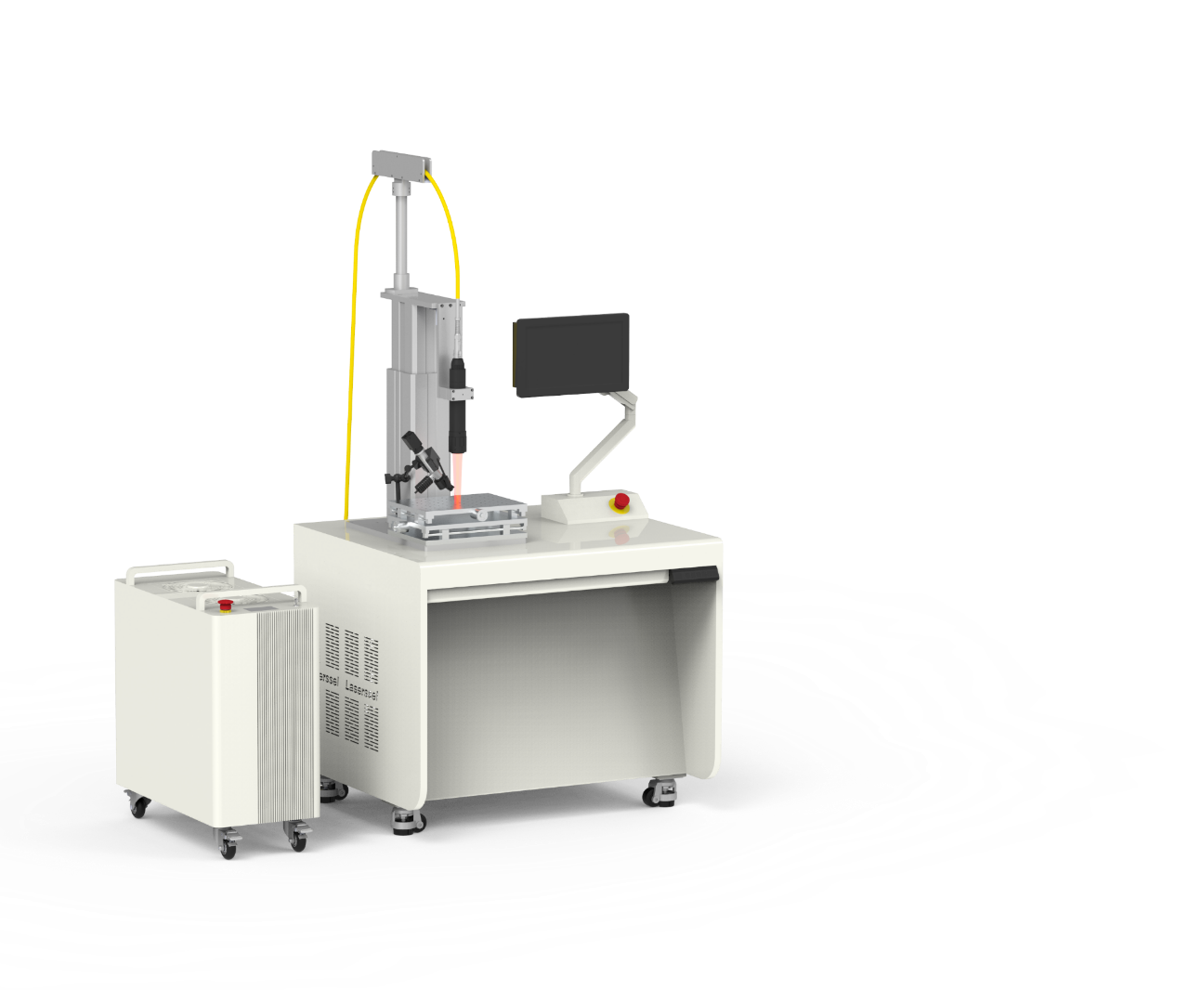

aLSR
Laser Solder Reflow System

Slide 2
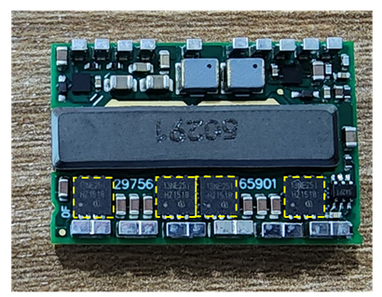
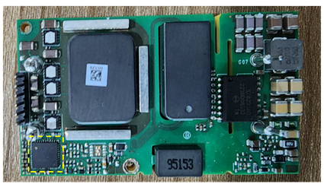
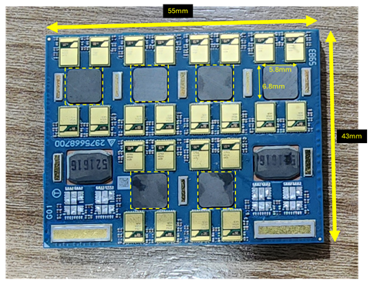
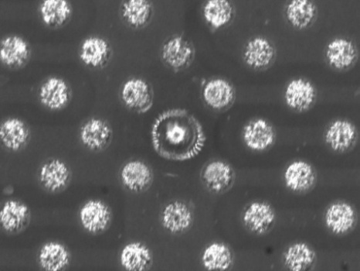
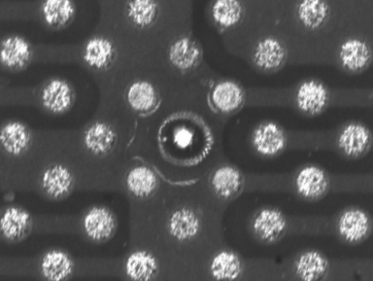
Customer’s Rework Applications and Proposed Solutions
Proposed Laser Beam Solutions:
5 x 5 mm Top Flat Laser Beam to reflow small components up to 5 x 5 mm size
5 x 5 mm + 100 x 100 µm dual beam to reflow 600 µm solder ball
2

Slide 3
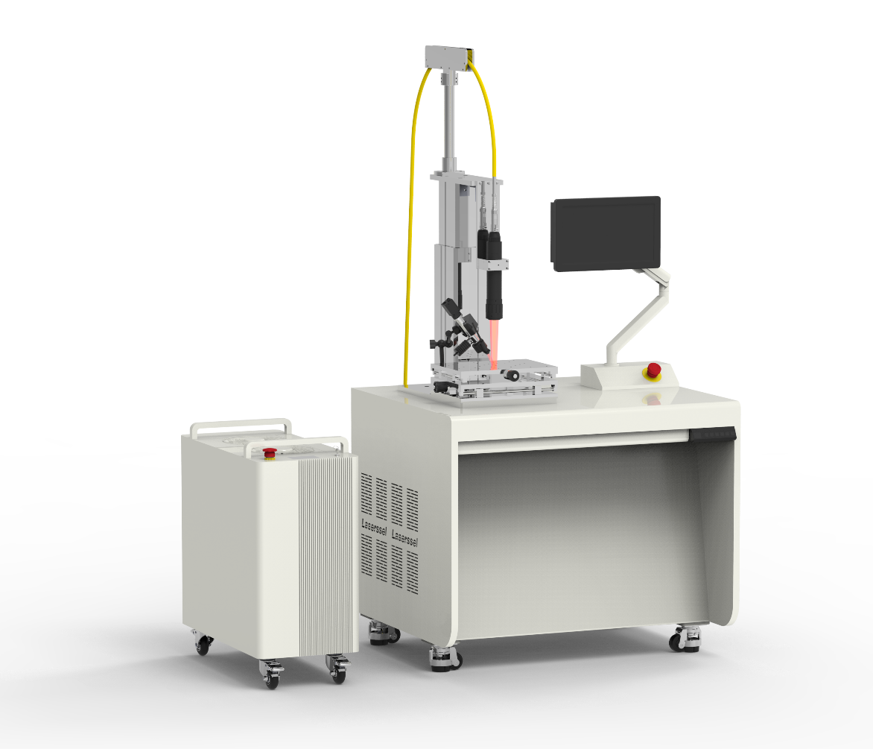
LSR_TB General Specifications
Area Laser Selective Reflow designed for rework purposes
 | Specification
Laser | 200W / 30 W
Area Beam Size | Laser Beam 5 x 5 mm fixed/ 100 x 100 µm fixed
Accessories | 13” Tablet PC
 | IR Camera temperature profiler
 | 8x magnification camera vision
Stage | X/Y Manual Stage + Motorised Z-Axis for focus control
Dimension | 900 x 750 x 1980mm
Lead Time | 4-5 months
Research EQ for Fast & Reliable metallic joints with Area Laser
3

Slide 4
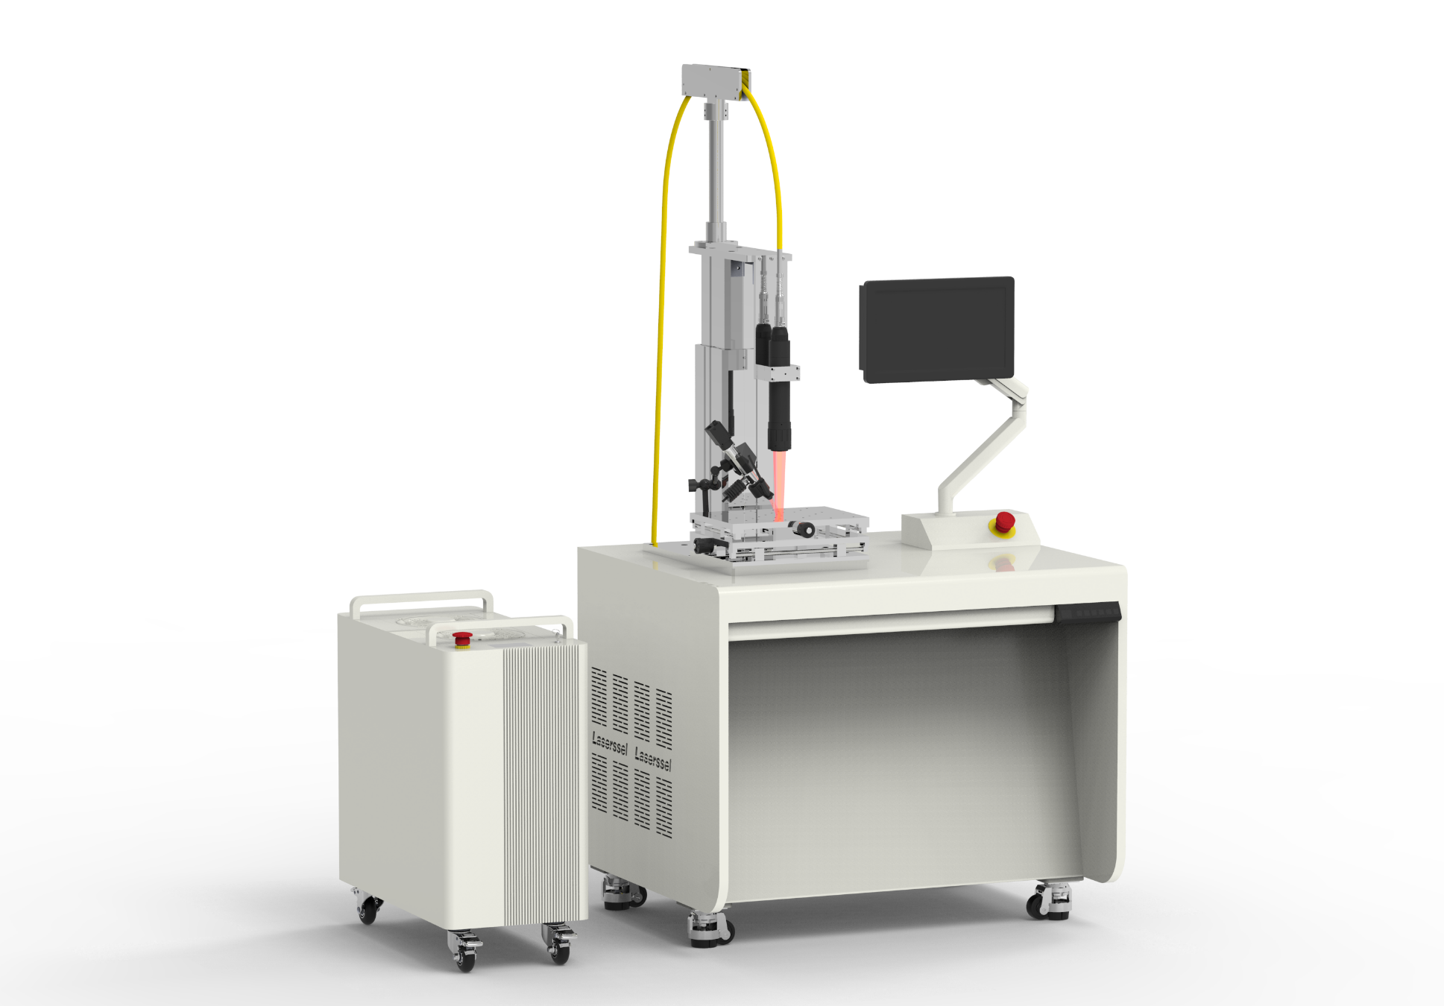
Machine Configurations
Laser Head on motorised Z-axis
IR Camera (temperature profiling)
Control PC
EMO(Emergency Stop)
X/Y Stage
Work Bench
4

Slide 5
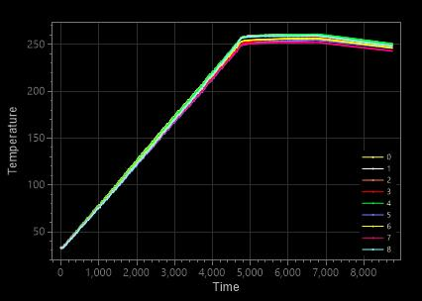
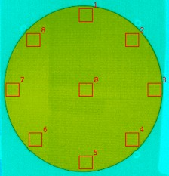
IR camera
Head Unit
The IR camera provides real-time surface temperature monitoring once calibrated. It is a convenient tool for reflow profile development and process monitoring.
The example below shows the camera monitoring the temperature across a 12-inch wafer. This highlights the IR camera's precision.
IR Point No. | Peak Temp. (℃)
0 | 260.6
1 | 260.5
2 | 260.4
3 | 257.4
4 | 260.9
5 | 254.9
6 | 256.7
7 | 253.4
8 | 259.4
Max-Min | 7.5
Average | 258.2
Notes:
더 많은 내용 추가할 것

Slide 6
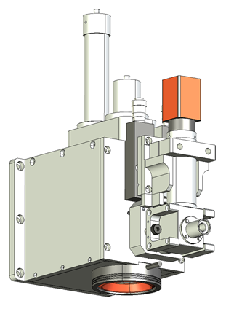
Laser and Vision Head
The Laser and Vision Head integrates three coaxial functions with the same focal length: a vision system and two lasers of different sizes and wavelengths.
2) 980nm Laser Beam
Beam Size : 5 x 5 mm
Solder ball pre-heating / QFN and QFP reflow
1) 808nm Laser Beam
Beam Size : 100 x 100 µm
Solder ball reflow
3) Coaxial Camera Vision
Down-looking camera vision with 8x magnification
Real-time viewing and monitoring

Slide 7
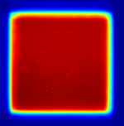
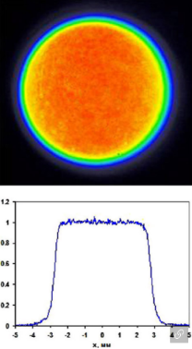
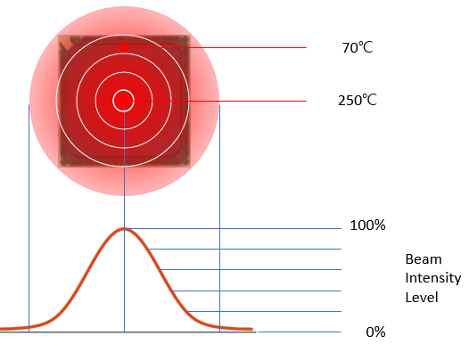
Laser Beam for Solder Ball and QFN/QFP Rework
Dual-Beam Laser Rework for BGA and Solder Balls
The system employs a dual-beam strategy to minimise thermal stress during solder ball rework. A large 5x5 mm flat-top laser beam is first used to uniformly preheat the surrounding board area. This is followed by a precise 100x100 µm spot laser, which raises the temperature of the target solder ball to its melting point to complete the reflow process. This method prevents localised thermal damage and ensures a reliable connection.
Single-Beam Rework for QFN/QFP Packages
For QFN/QFP packages, only the 5x5 mm flat-top laser beam is activated to perform the rework. This single, uniform beam is sufficient for these specific package types.
Coaxial Dual Beam Laser Head
5 x 5 mm area for preheating
100 x 100µm for solder ball reflow
Large Beam
Small Beam

